Slide 1
Hashing

Slide 2
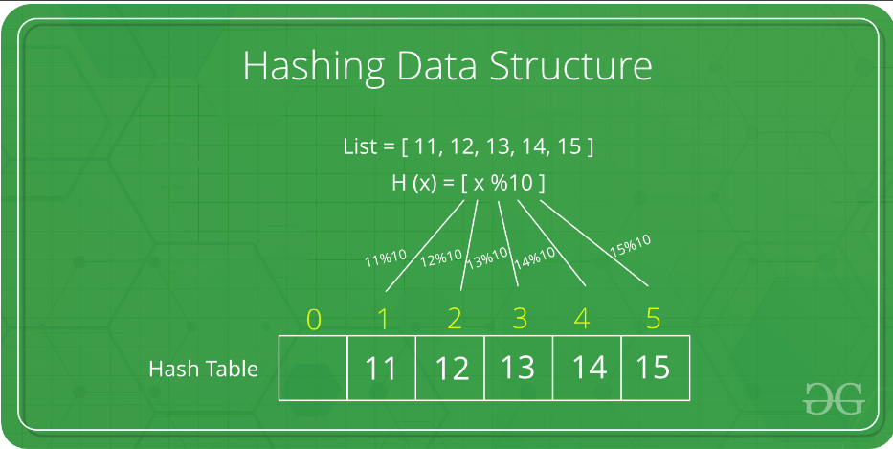

Slide 3
Introduction to Hashing:
Hashing is a technique used to map data to a fixed-size array, known as a hash table or hash map.
It enables efficient retrieval, insertion, and deletion of data based on a key.

Slide 4
Key Components of Hashing:
Key: The unique identifier used to access data.
Hash Function: Converts the key into an index or hash code for efficient storage and retrieval.
Hash Table: The data structure that stores key-value pairs based on the hash code.

Slide 5
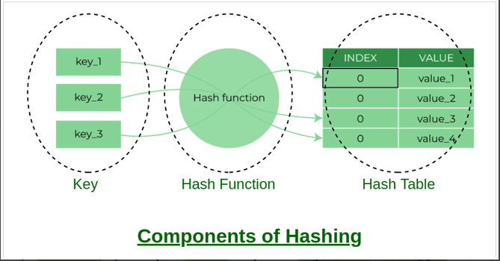

Slide 6
How Hashing Works:
The hash function processes the key to generate a hash code.
The hash code is used as an index to store or retrieve the corresponding value in the hash table.
Ideally, the hash function should distribute the keys uniformly across the hash table to minimize collisions.

Slide 7
Benefits of Hashing:
Fast data retrieval: Hashing allows for constant-time access to data, resulting in efficient retrieval operations.
Efficient storage: Hashing reduces the storage requirements by mapping keys to fixed-size arrays.
Supports key-value pairs: Hashing enables storing and accessing data in key-value pairs, allowing for flexible data structures.

Slide 8
Collision Resolution:
Collisions occur when two or more keys map to the same hash code/index.
Various collision resolution techniques exist, such as chaining (using linked lists) or open addressing (probing methods like linear or quadratic probing).

Slide 9
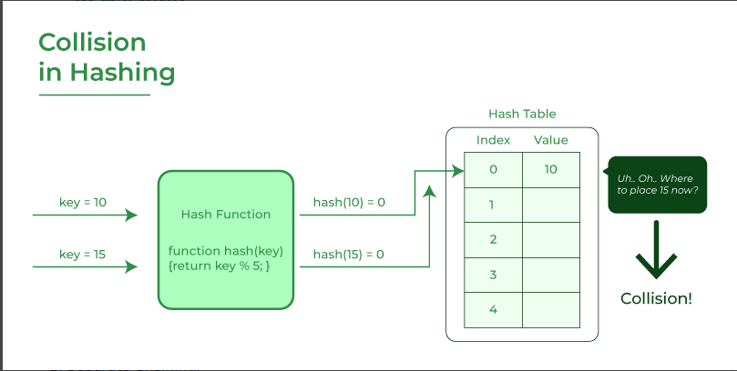

Slide 10
Common Applications of Hashing:
Databases: Hashing is used for indexing and fast retrieval of records based on keys.
Caching: Hashing is utilized for quick cache lookups and eviction strategies.
Password Storage: Hash functions ensure secure storage of passwords by generating irreversible hash codes.

Slide 11
Conclusion:
Hashing is a powerful technique for efficient data storage and retrieval based on keys.
Choosing an appropriate hash function and collision resolution strategy is crucial for optimal performance.

